Slide 1

Airline Reviews Sentiment Analysis
Anuhya Ramaraju
Jagruti B Jethwani
Krishna Pratheek Seshabhattar
Vamsi Tanneru
Vishnu Sai Tharun Kumar Uppugunduri
Notes:
anuhya

Slide 2
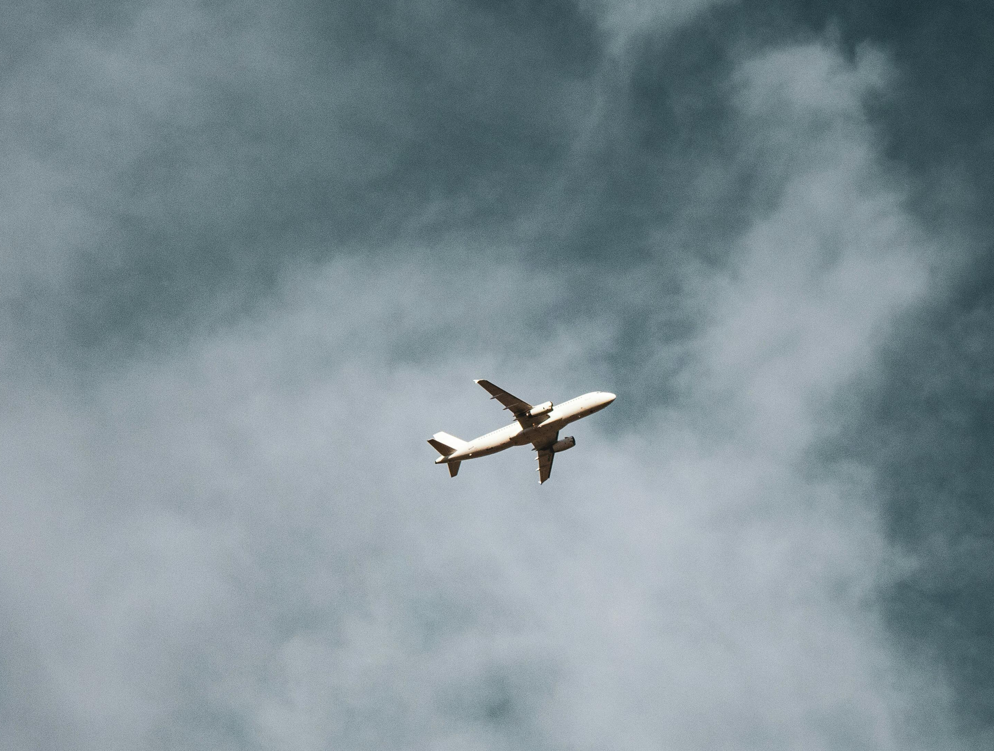
AGENDA
7
6
5
4
Recommendations
3
Research Questions
2
Text Preprocessing
1
EDA
Data Transformation
Initial Dataset Overview
Introduction
Notes:
anuhya

Slide 3
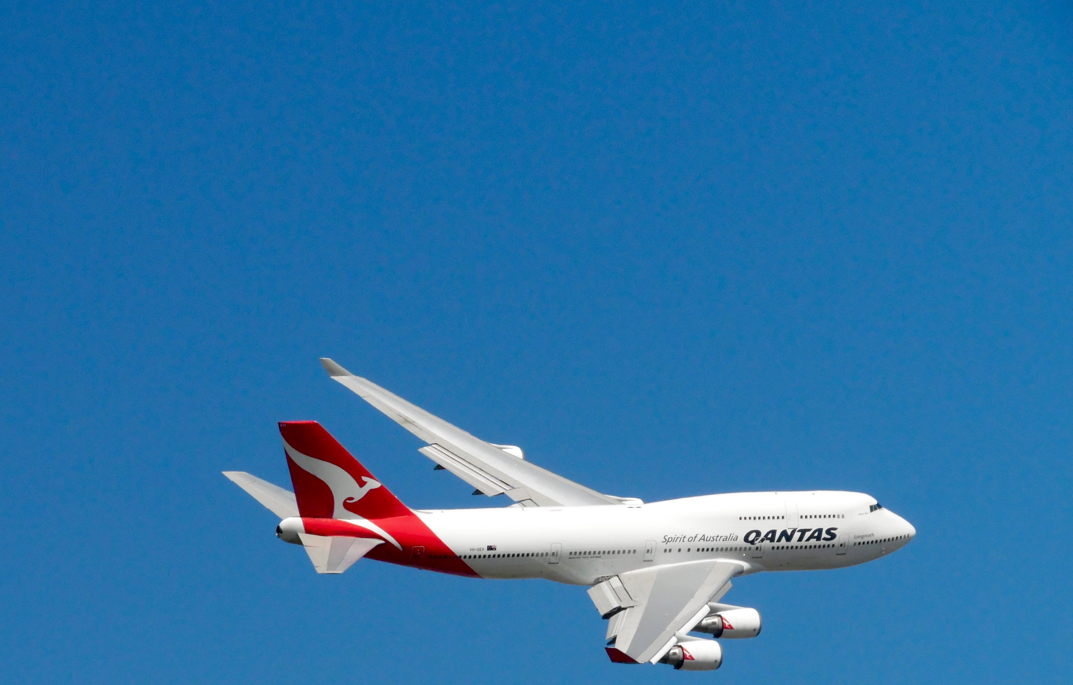
INTRODUCTION
NAVIGATING AIRLINE
OPTIONS
1
Airlines are key to global travel, ensuring safety, comfort, and a great flying experience.
ROLE OF AIRLINES
2
The project analyzes various airlines, considering their performance against passenger feedback.
DATA DRIVEN
RECOMMENDATIONS
3
We aim to clarify airline selection by leveraging key insights and identifying consumer trend patterns.
ROLE OF DATA ANALYSIS
The collected information underpins recommendations for improvements and pinpoints key issues unique to different traveler groups, highlighting data's role in fostering advancements in the airline industry.
4
Notes:
vamsi

Slide 4
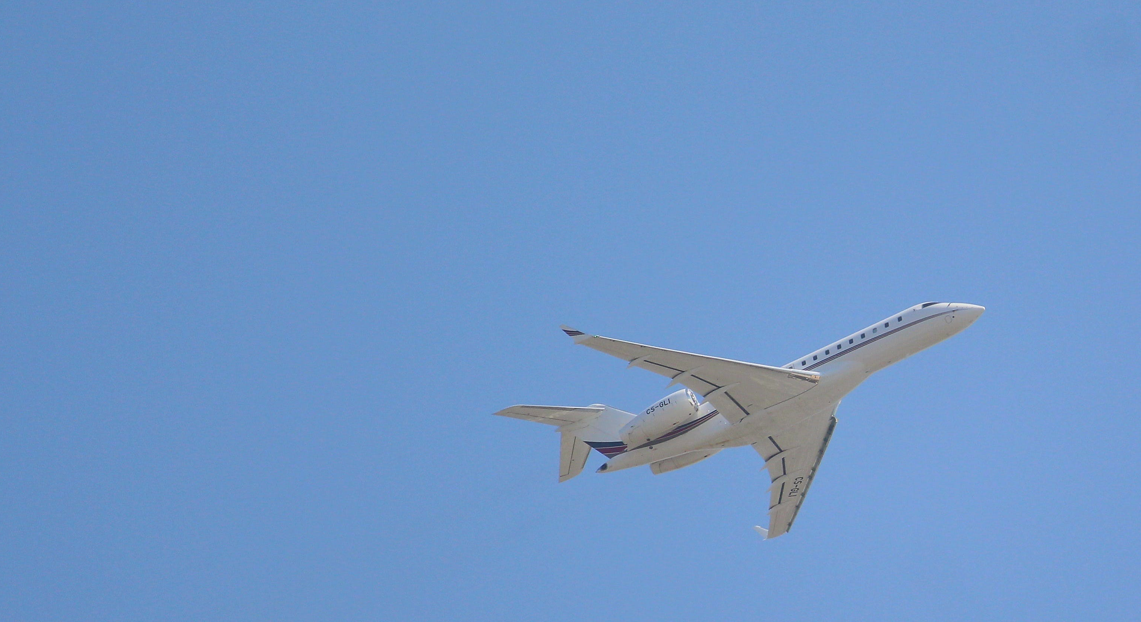
Airline Names
Aircraft Name
Overall Rating
Basic Information
Flight Type and Traveler
Traveler Type
Review Title
Seat Type
Review Date
Route
Review
Date Flown
DATA OVERVIEW
Seat Comfort
Inflight Entertainment
Cabin Staff Services
Customers Ratings
Final Assessment
Value for Money
Ground Service
Recommendation
Wifi and Connectivity
Food and Beverages
Notes:
vamsi

Slide 5
DATA TRANSFORMATION
Created New Columns
Geolocation API
Selected Airlines with 100 reviews each
Dropped Irrelevant Columns
Handled Missing Values
Notes:
vamsi

Slide 6
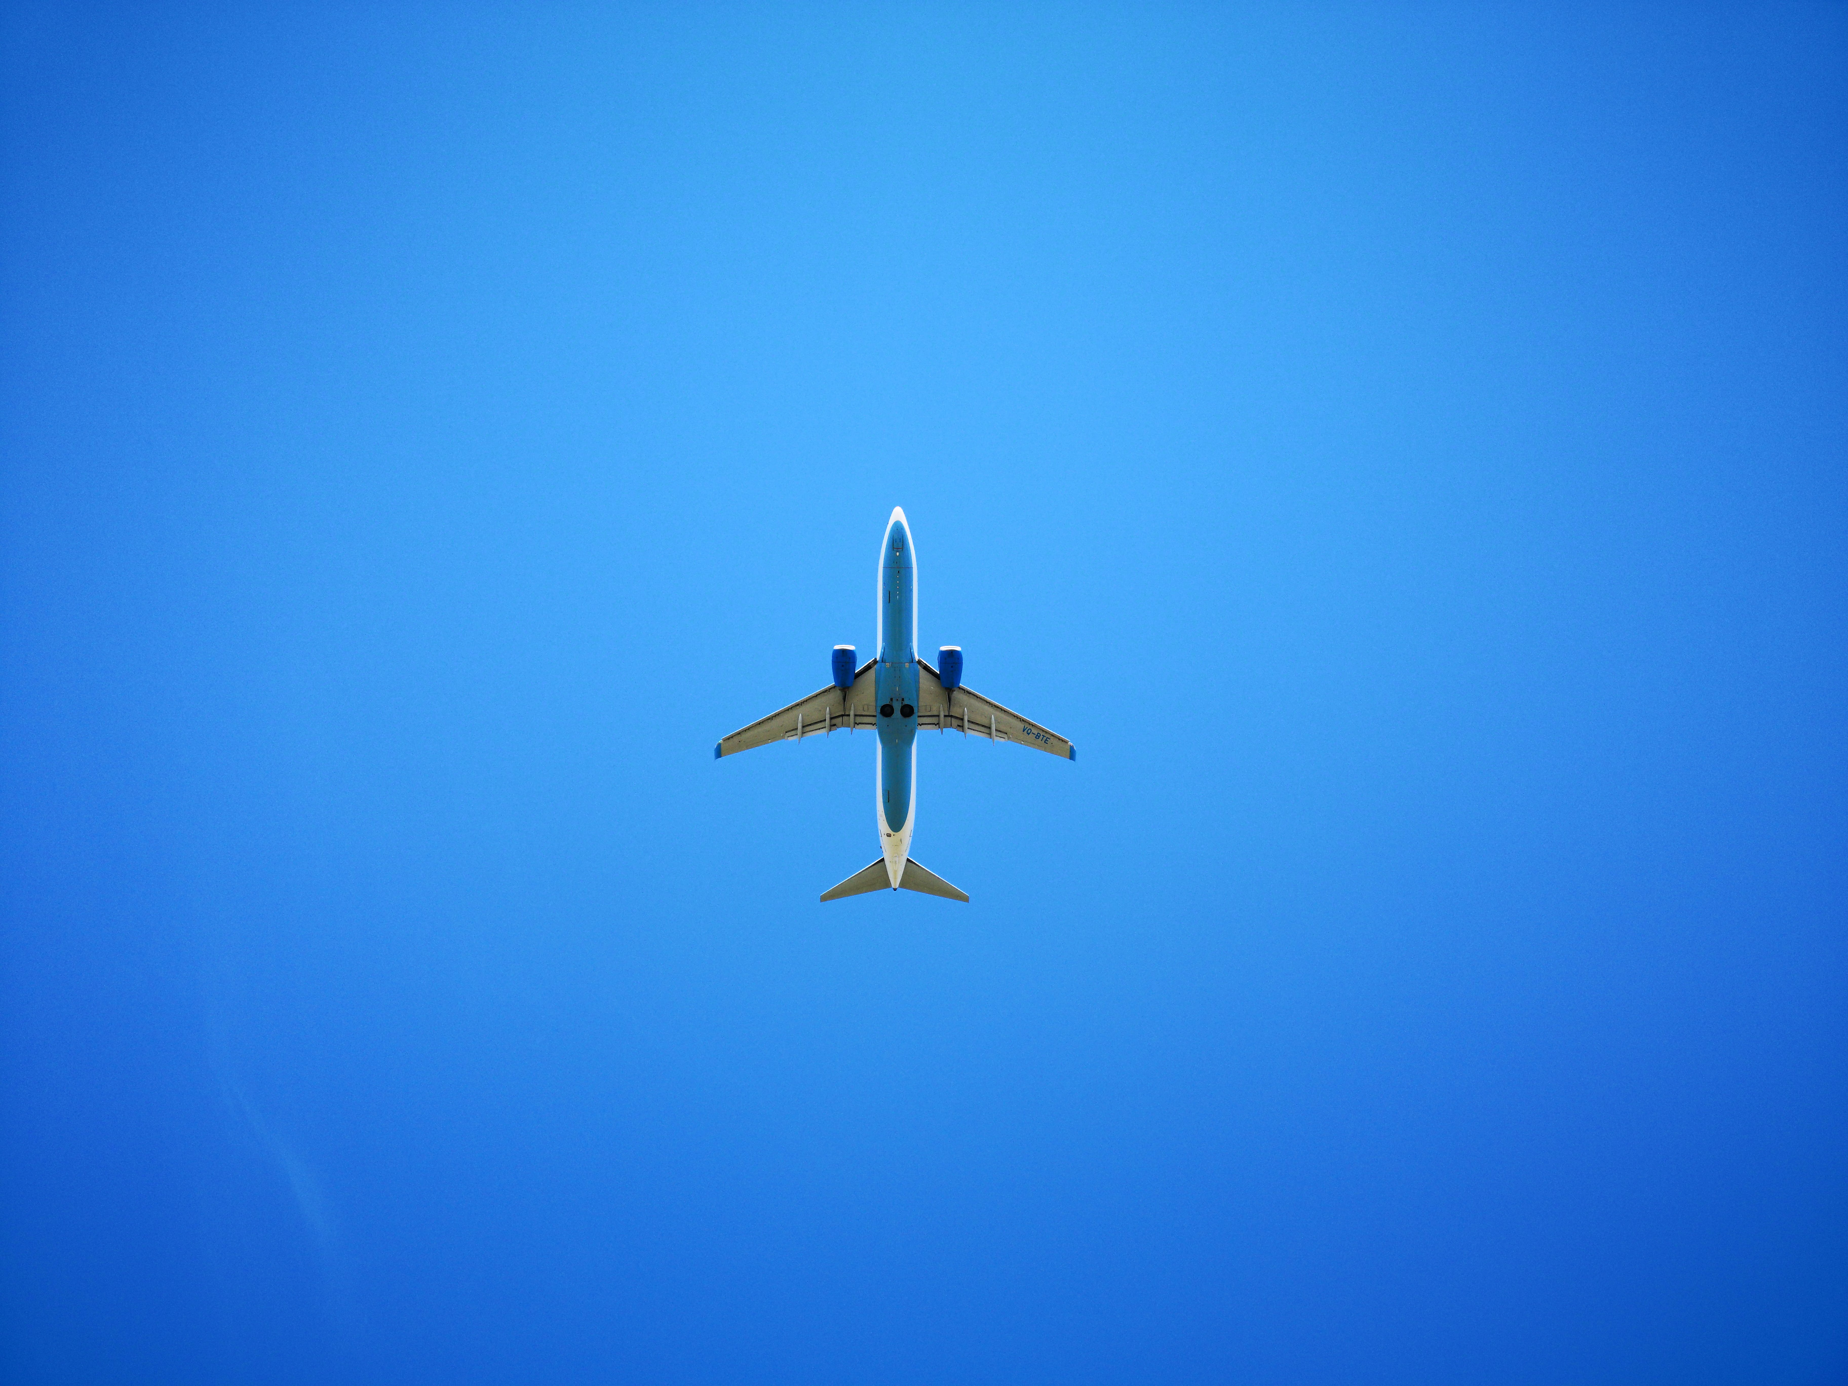



Airline Name
Overall Rating
Date Flown
Review Title
Departure Cities
Review text
Destination Cities
Seat Type
Flight Type
Type of Traveler
TRANSFORMED DATASET
Seat Comfort
Departure in USA
Inflight Entertainment
Destination Country
Cabin Staff Services
Ground Service
Destination in USA
Wifi and Connectivity
Food and Beverages
Airline and Flight Information
Customer Review Components
Additional Flight Details
Satisfaction Ratings
Notes:
vamsi

Slide 7
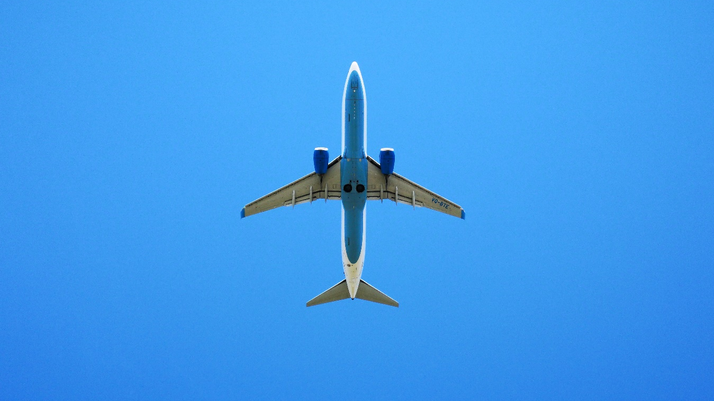
Let’s Explore the Data
Notes:
tharun

Slide 8
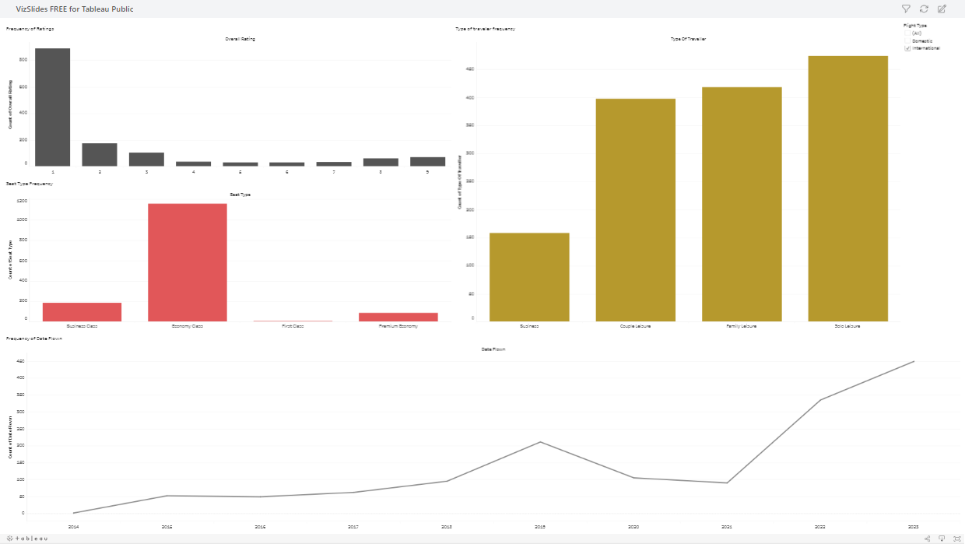
Notes:
tharun

Slide 9
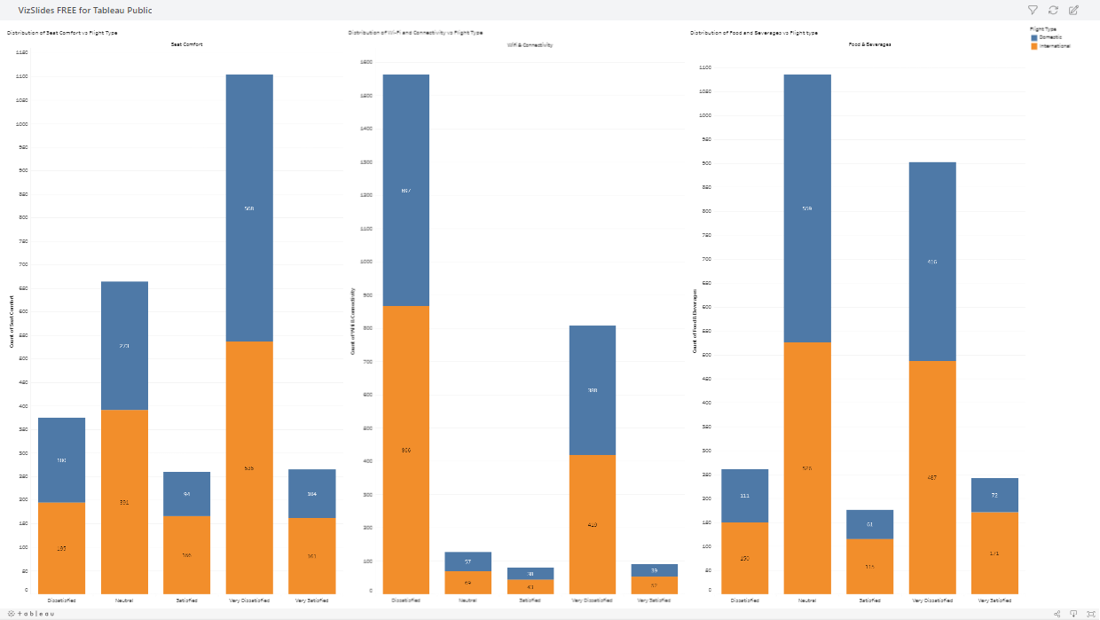
Notes:
tharun

Slide 10
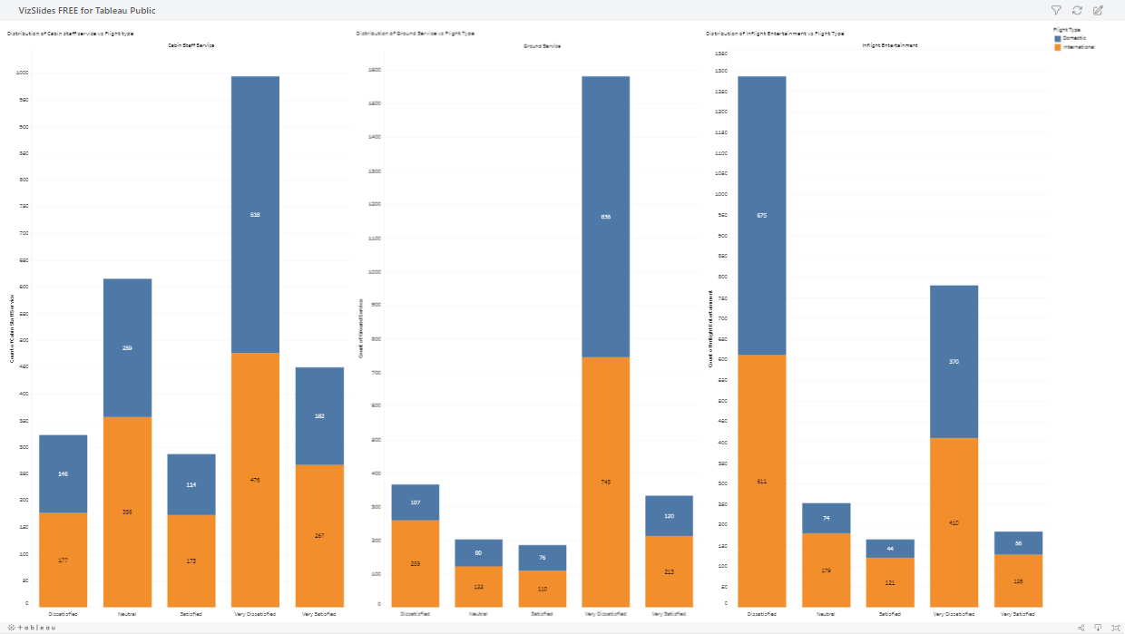
Notes:
tharun

Slide 11

TEXT PREPROCESSING
Tokenization
Stop Words Removal
Stemming
Breaking down text into individual words or phrases to facilitate easier analysis and processing in natural language tasks
Eliminating common words (such as 'and', 'the', 'is') from text data to focus on more meaningful words for analysis.
Reducing words to their root form, simplifying text analysis by treating different forms of a word as the same base word
Our plane left quite late from Seattle with no explanation, and we ended up getting into Dublin several hours late missing our connecting flight
plane left quit late seattl explan end get dublin sever hour late miss connect flight
Notes:
p

Slide 12
TEXT ANALYSIS
VADER
Natural Language Processing
TEXTBLOB
A lexicon and rule-based sentiment analysis tool, particularly adept at handling sentiments expressed in social media contexts, including slang, emoticons, and abbreviations. Ideal for real-time sentiment assessment.
A Python library for processing textual data, offering straightforward API for sentiment analysis. Utilizes pattern analysis and natural language processing techniques to provide both polarity and subjectivity scores, making it suitable for diverse text types.
Notes:
pratheek

Slide 13
TEXT ANALYSIS
Natural Language Processing
VADER
TEXTBLOB
plane left quit late seattl explan end get dublin sever hour late miss connect flight
plane left quit late seattl explan end get dublin sever hour late miss connect flight
-0.5903
-0.081578947
Notes:
pratheek

Slide 14

Research Question 1:
How do the sentiment scores generated from Vader and TextBlob change over the years among domestic and international flights. What can we make out of it.
Notes:
jagruti

Slide 15
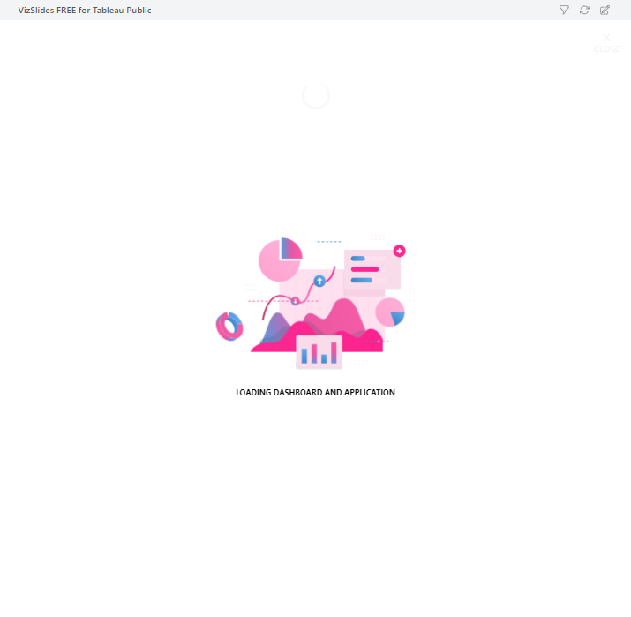
Notes:
jagruti

Slide 16
Research Question 2:
What are the airlines that have a low sentiment generated from Vader among the domestic and international airlines? How can they Improve the experience of their customers?
Notes:
anuhya

Slide 17
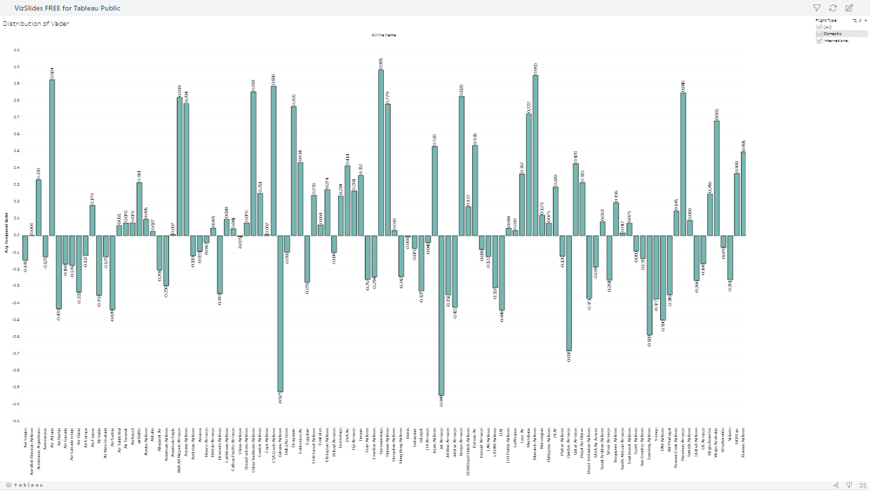
Notes:
anuhya

Slide 18
Research Question 3:
What are the airlines that have a low sentiment generated from TextBlob among the domestic and international airlines? How can they Improve the experience of their customers?
Notes:
vamsi

Slide 19
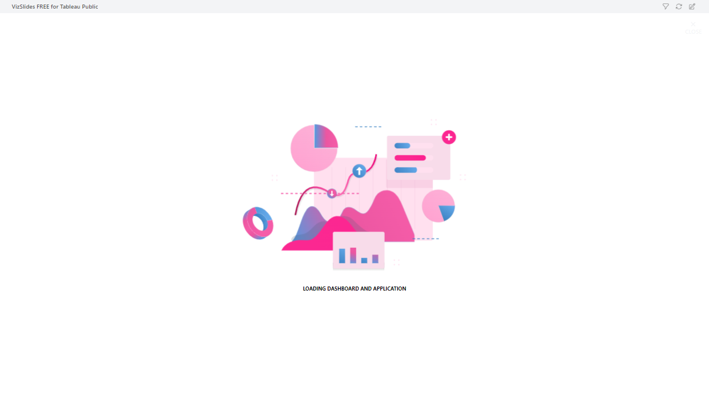
Notes:
vamsi

Slide 20
Statistical proof for Questions 2 and 3
Vader
International
Airline Name | T-statistic | p-value | one tail p-value | result
United Airlines | -4.140990195 | 0.000278 | 0.000138829 | significant
Royal Jordanian Airlines | -3.334113892 | 0.003006 | 0.00150287 | significant
Interjet Airlines | -3.615396056 | 0.000981 | 0.000490256 | significant
Domestic
Frontier Airlines | -2.337898075 | 0.021785 | 0.010892534 | significant
Silver Airways | -2.410282864 | 0.018103 | 0.00905162 | significant
Jetblue Airways | -3.339151357 | 0.001279 | 0.00063972 | significant
TextBlob
International
Airline Name | T-statistic | p-value | one tail p-value | result
Jetblue Airways | -3.610395677 | 0.00393 | 0.001964992 | significant
Volaris | -1.608098908 | 0.122484 | 0.061242245 | not significant
Interjet Airlines | -3.295259248 | 0.002409 | 0.001204717 | significant
Domestic
American Airlines | -2.79001603 | 0.006596 | 0.003297829 | significant
Spirit Airlines | -3.068540452 | 0.002811 | 0.001405262 | significant
United Airlines | -2.403559328 | 0.019203 | 0.009601252 | significant
Notes:
tharun

Slide 21
Research Question 4:
How are the flights performing according to the satisfaction score given by the travelers for the departments which are crucial during a flight
Notes:
pratheek

Slide 22
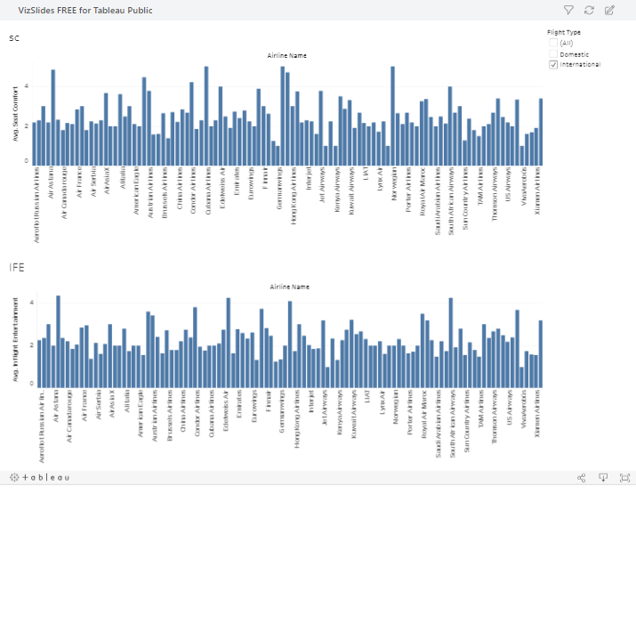
Notes:
pratheek

Slide 23
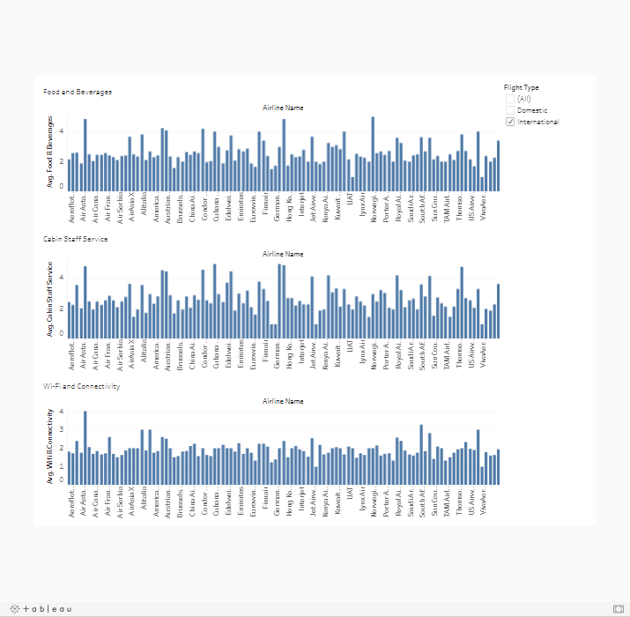
Notes:
pratheek

Slide 24
Research Question 5:
How are the flights performing according to the satisfaction score given by the travelers for the Ground Service department
Notes:
jj

Slide 25

Notes:
jj

Slide 26
Department Name | Flight Type | Air Line Name | Other Airlines Observations | T-test | P-Value | One-Tail P- Value | Result
Cabin Staff Service | Domestic | Silver Airways | 1145 | -4.0689073 | 0.0001 | 5.20E-05 | Signif
 | International | Frontier Airlines | 1361 | -42.54500403 | 3.43E-252 | 1.72E-252 | Signif
Food And Beverages | Domestic | Spirit Airlines | 1133 | -4.214248364 | 5.39E-05 | 2.70E-05 | Signif
 | International | Avianca | 1344 | -5.133687256 | 2.37E-05 | 1.19E-05 | Signif
Inflight Entertainment | Domestic | Spirit Airlines | 1133 | -7.769401 | 1.52E-12 | 7.61E-13 | Signif
 | International | Flair Airlines | 1356 | -4.08741 | 0.0247 | 0.0123 | Signif
Seat Comfort | Domestic | Allegiant Air | 1133 | -6.1133 | 1.49E-08 | 7.43E-09 | Signif
 | International | Jetblue | 1357 | -0.47403 | 0.644 | 0.323 | Non-Signif
Wifi and Connectivity | Domestic | Spirit Airlines | 1133 | -7.10662 | 7.10E-11 | 3.55E-11 | Signif
 | International | Flair airlines | 1365 | -2.659812 | 0.07490916 | 0.0374545 | Signif
Ground Service | Domestic | Frontier Airlines | 1146 | -7.99929 | 3.81E-13 | 1.90E-13 | Signif
 | International | TAM Airlines | 1354 | -2.94363 | 0.0102 | 0.005 | Signif
Statistical proof for questions 4 and 5
Notes:
jj

Slide 27
Recommendations for the Airlines across all Departments
Inflight Entertainment
Food and Beverages
Wi-Fi and Connectivity
Cabin Staff Service
Ground Service
Seat Comfort
Investing in R&D for new options
Implementing Dynamic Pricing for Seat Upgrades
Seeking Expert Advice from Ergonomics Specialists
Introducing Interactive Seat Maps
In seat fitness programs like stretches and breathing exercises that can help passengers relax.
Providing Family-Friendly Entertainment
Personalized Content for Solo Travelers using strategic partnerships
Collaboration with Gaming Companies
Introduce bite sized learning opportunities
Integrating screen mirroring/airplay
Enhancing Meal Choices for Children
Enhancing the Local Flavor
Collaboration with Renowned Chefs
Wine-Pairing and Sommelier Services
Options to pre-order customizable meals to cater to dietary restrictions
Family-Oriented Wi-Fi Plans
Cutting-Edge Connectivity Solutions
Optimized Wi-Fi Packages for Solo Travelers
Strong Wi-Fi Infrastructure for Economy Class
Investment in Enhanced Cybersecurity
Improve working conditions and opportunity for growth for cabin staff
Cultural Immersion Content
In-Flight Concierge Service for Business Class
Pop-up events, contests, eco-friendly initiatives, and more
Family-Friendly Check-In Services
Solo Traveler Assistance and Networking
Exclusive Offers for Leisure Travelers
Invest in superior technology that can help save lost bags
Expedited Services for Business Travelers
Pre-Flight Networking Events
Notes:
jj

Slide 28
REFERENCES
SkyRatings: Unleashing 23K+ Airline Reviews! | Kaggle
J. D. Hunter, "Matplotlib: A 2D Graphics Environment, Computing in Science & Engineering”, https://ieeexplore.ieee.org/document/4160265
​​Oliphant, T. E. (2006). NumPy: A fundamental package for scientific computing with Python. Computing in Science & Engineering, 9(3), 10-20. https://ieeexplore.ieee.org/document/4160250
Waskom, M. (Apr,2021). seaborn: statistical data visualization. Journal of Open Source Software, https://joss.theoj.org/papers/10.21105/joss.03021
Amos, D. (2021, October 1). Understanding Python Pickling and Unpickling. Real Python. https://realpython.com/python-pickle-module/
Bird, S., Loper, E., & Klein, E. (2009). Natural Language Processing with Python. https://www.nltk.org/book/
Hutto, C. J., & Gilbert, E. (2014). VADER: A Parsimonious Rule-Based Model for Sentiment Analysis of Social Media Text. https://ojs.aaai.org/index.php/ICWSM/article/view/14550/14399
matplotlib. (n.d.). 'matplotlib.pyplot.legend'. Matplotlib Documentation. https://matplotlib.org/stable/api/_as_gen/matplotlib.pyplot.legend.html
TextBlob. (n.d.). TextBlob: Simple Pythonic text processing. Retrieved October 1, 2023, from https://textblob.readthedocs.io/en/dev/
Notes:
jj

